Slide 1



Do it Like the Doctor: How We Can Design a Model That Uses Domain Knowledge to Diagnose Pneumothorax
Glen Smith
PhD Student, Drexel University
glen.r.smith@drexel.edu
Qiao Zhang
PhD Student, Drexel University
qz99@drexel.edu
Christopher J. MacLellan
Assistant Professor, Drexel University
christopher.maclellan@drexel.edu
https://tail.cci.drexel.edu
Notes:
https://aaai.org/conference/spring-symposia/sss23/#ss03

Slide 2
Contents
DARPA POCUS & Pneumothorax
Current Approaches and Limitations
Our Approach
Key Takeaways
Design Recommendations
Ongoing Work
The Problem

Slide 3
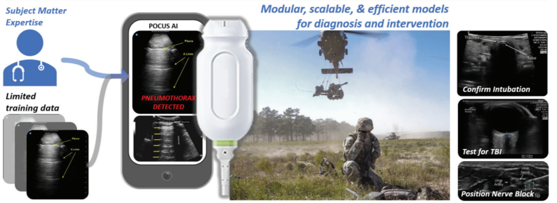
DARPA POCUS Program
Notes:
This work is a part of the DARPA pocus program and as part of this program, we are examining four pocus tasks, the first of which is pneumothorax which we’ll discuss today

Slide 4
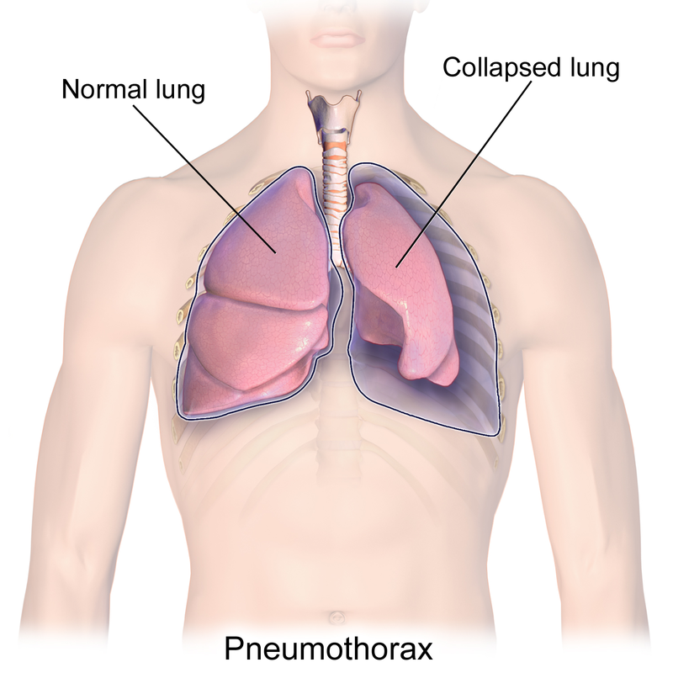
Pneumothorax
Notes:
PTX is simply put a collapsed lung, which is presented in this image
When Doctors diagnose PTX, the POCUS device is placed at the location of the lungs
When the lung is normal, the lung and the chest wall are in contact, shown on the left. You are able to observe the motion between the lung and chest wall in the ultrasound image
In the case of a collapsed lung, the lung is no longer in contact with the chest wall and so the ultrasound device is only able to see the chest wall and no motion is observed
Now that we know what PTX is, next we want to understand the process that Doctors employ to diagnose PTX
A tried and true method to understand the process that a human goes through is called Cognitive Task anlaysis

Slide 5
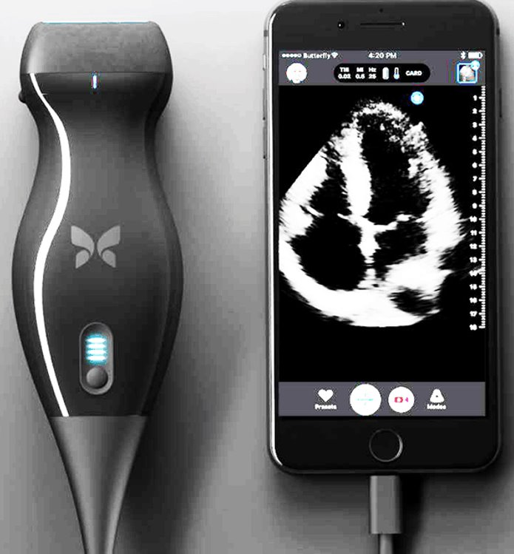
The Problem
Point-of-care ultrasound (POCUS) has the potential to address a broad range of battlefield injuries.​
New ultrasound technology makes it possible to deploy the technology in austere environments.​
However, most medics are not trained in the use of ultrasound, which makes it difficult to use the technology more widely.​
AI models that can automatically diagnose and interpret POCUS imagery on mobile devices should decrease training burdens and increase pocus usage on the battlefield
Notes:
Point-Of-Care Ultrasound, involves the use of an ultrasound device to answer specific diagnostic questions and to assess real-time physiological responses to treatment
Point-of-care ultrasound (POCUS) has the potential to address a broad range of battlefield injuries.​
Newer and more advanced ultrasound technology makes it possible to deploy the technology in dynamic, high-stakes, and austere environments.​
However, what we find is that most medics are not trained in the use of ultrasound, which makes it difficult to adopt the technology more widely.​
So, what we want to do is build AI models that can automatically diagnose and interpret POCUS imagery on mobile devices, which should decrease training burdens and increase pocus usage on the battlefield

Slide 6

Current Approaches and their Limitations
The current state of the art is to employ deep statistical learning models, such as convolutional neural networks, to learn POCUS classifiers.​
However, current POCUS AI suffer several limitations:​
They require a large amount of labeled data to achieve robust performance.​
They tend to overfit and are susceptible to adversarial examples.​
They suffer from catastrophic forgetting.​
They do not use domain knowledge and as a result use surface rather than deep features.​
They are not transparent or explainable, reducing medic confidence and adoption.
Notes:
The current state of the art is to employ deep statistical learning models, such as convolutional neural networks (CNNs) , to learn POCUS classifiers.​
But we find that, current POCUS AI suffer several limitations:​
They require a large amount of labeled data to achieve robust performance.​
They tend to overfit and are susceptible to adversarial examples.​
They suffer from catastrophic forgetting, meaning previously learned examples can be forgotten when presented with newer examples
They do not use domain knowledge and as a result use surface rather than deep features.​
They are not transparent or explainable, reducing medic confidence and adoption.

Slide 7
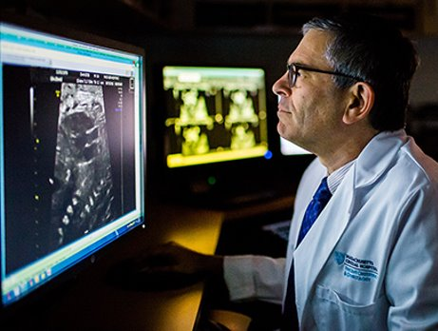
Think-Aloud Analysis
“So, the first thing I want to identify...I want to identify the pleural line, and so to identify the pleural line, I identify a rib... And so, I know that the line, that is just underneath. And then I look at the movement because the question is “sliding” or “no sliding”. I want to see an independent movement of sliding that could be seen here. So, this is not a Pneumothorax for sure.”
Notes:
1.
Think Alouds (TAs) are one specific type of cognitive task analysis that asks participants to verbalize each step in their problem-solving process
We conducted one-on-one sessions where the doctors are asked to diagnose PTX and think aloud while doing so
Shown here is an example of a complete verbal protocol from one of our doctors diagnosing PTX from an ultrasound video
*Read quote*

Slide 8
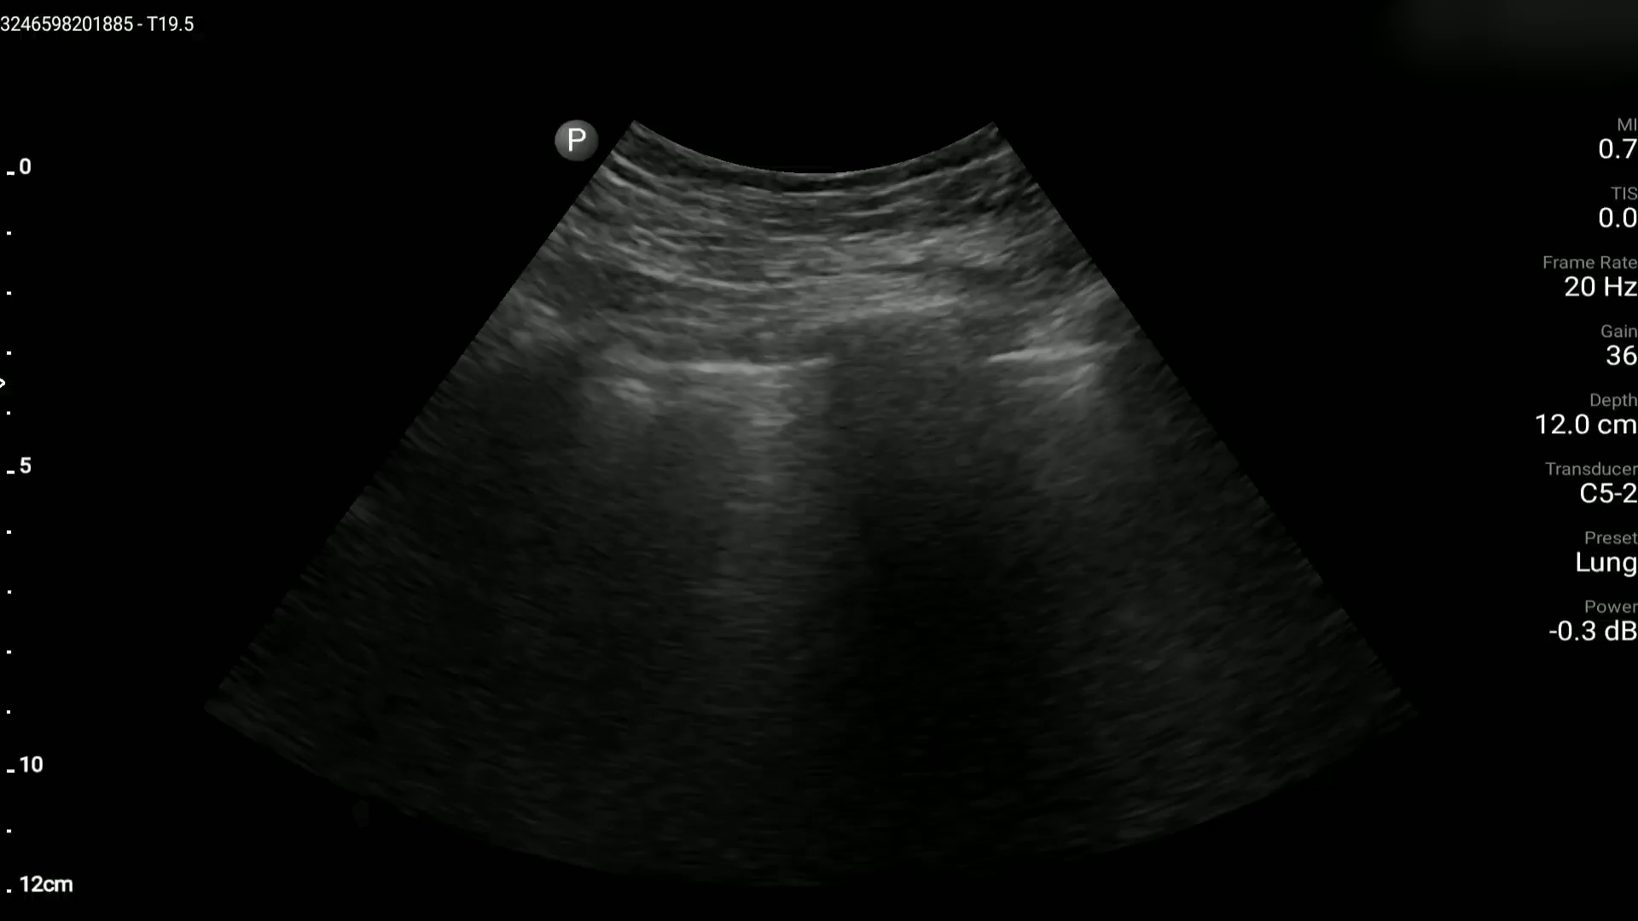
The Data
The POCUS Atlas data
Labeled with “pneumothorax” or “no pneumothorax”
Brooke Army Medical Center (BAMC) data
Labeled with “sliding” or “no sliding”
“no sliding” is a proxy for Pneumothorax
Notes:
The data from the work comes from two sources: The POCUS Atlas and BAMC
The data from the POCUS atlas is labeled directly as “PTX” or “no PTX”
In contrast, the data from BAMC is labeled as “sliding” or “no sliding”
One of the features most indicative of PTX is a lack of sliding in the pleural line, so the BAMC data is labeled “no sliding”/”sliding” as a proxy for PTX/no PTX

Slide 9
Study 1
Motivation: Determine the features and characteristics doctors use to diagnose Pneumothorax
Approach:
For each Doctor, we conducted two think-aloud sessions where we asked them to “make a diagnosis of Pneumothorax”
We used POCUS Atlas data in the first session and the BAMC data in the second session
Sessions consisted of 6 diagnoses: 3 videos were in the positive class and 3 were in the negative class in random order
We extracted task-relevant keywords from the transcripts of the Think-Aloud sessions
Notes:
- Given this data, the aim of Study 1 was to determine the features and characteristics doctors use to diagnose Pneumothorax
To do this, we applied the Think-Aloud method
For each doctor, for which we used the pseudonyms Alex and Victor, we conducted two Think-Aloud sessions where we prompted them to “make a diagnosis of Pneumothorax” where the CTA method employed here is direct observation and questioning
2.
3.
The videos were presented in a random order and each doctor was unaware of the true diagnosis of all videos until the end of the study.
4.
- Sessions were recorded, transcribed, and edited for accuracy

Slide 10
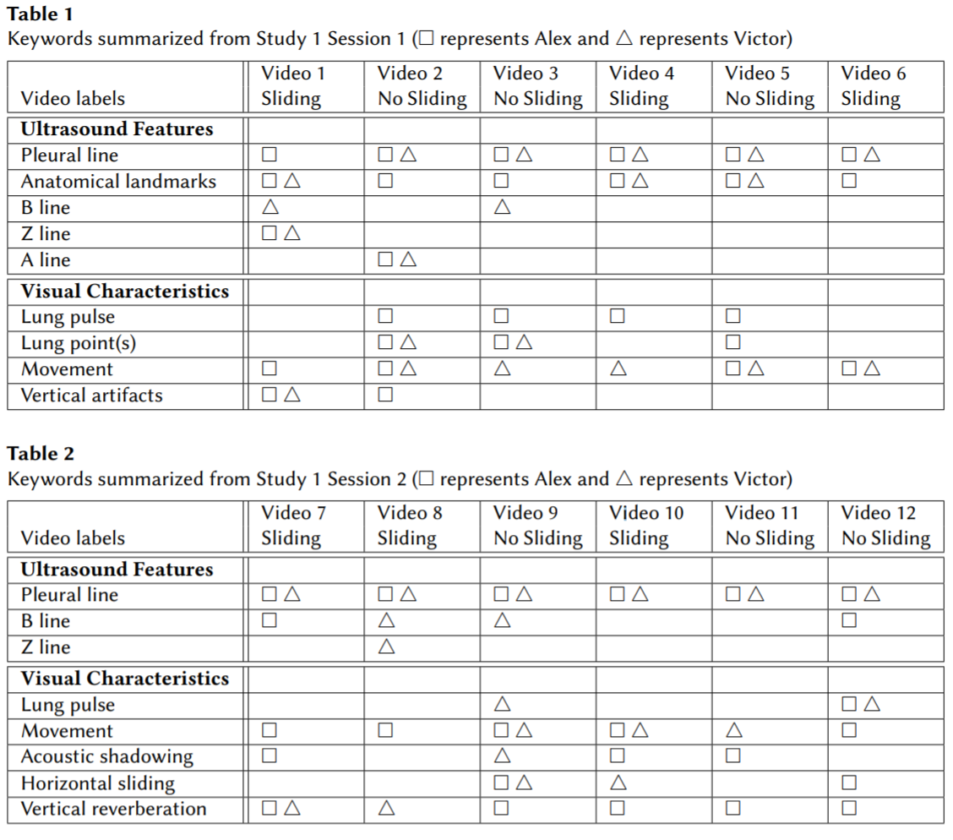
Study 1 Results
From these sessions, we observed twelve key concepts presented in the following tables
We further distinguished “ultrasound features” vs. “visual characteristics”
Notes:
1.
We observed twelve key concepts across sessions one and two, shown here
In our analysis, we distinguished between two types of concepts, “ultrasound features” and “visual characteristics”
We define “features” of the ultrasound, which are objects or regions in the video, and “visual characteristics”, which are characteristics the features exhibit, such as a type of movement.

Slide 11
Study 1 Results
Some concepts appear more frequently than others
Notes:
- For each video, we label which doctors mention which concepts, using the square for Alex and triangle for Victor
- Across these sessions, we noticed that some concepts are used more often than others

Slide 12
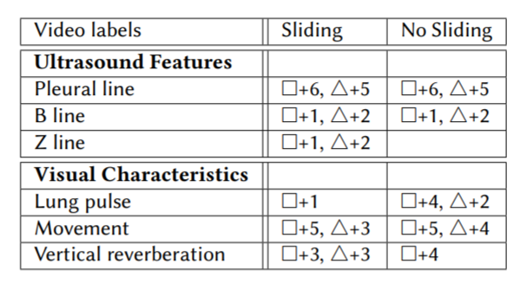
Study 1 Results
Summary table of concepts identified by both Doctors
Provides implications of relative importance of features
Notes:
- To explore this idea, we looked at the concepts that both doctors used and counted how many videos these concepts were used in
1.
This table summarizes the concepts both doctors mentioned across all sessions.

Slide 13
Study 1 Results
Summary table of concepts identified by both Doctors
Provides implications of relative importance of features
Notes:
2. Key Takeaways
In terms of ultrasound features, one of the key takeaways is that both doctors almost always identified the pleural line as part of diagnosing PTX. B lines and Z lines were only used in one or two instances.
- so while being present in the videos, they didn’t actually contribute much to the diagnosis

Slide 14
Study 1 Results
Summary table of concepts identified by both Doctors
Provides implications of relative importance of features
Notes:
2. Key Takeaways
In terms of visual characteristics, the predominant concept used was movement of the pleural line
“lung pulse” and ”vertical reverberation” were only used in some of the cases
From this study, we not only identify which concepts doctors use, we also get a sense of the relative importance of each concept
*One such model design could be an object (or feature) detector parameterized by the relative “weights” of those features. For example, we might build an object detector to identify the pleural line in an ultrasound video, so that subsequent analysis can focus on this feature.

Slide 15
Study 2
Motivation: Determine how doctors explain previously-generated Pneumothorax diagnoses
Approach:
For each Doctor, we conducted one Think-Aloud session where we asked them to explain pre-defined diagnoses of Pneumothorax
We presented doctors with four ultrasound videos, two “sliding” and two “no sliding”, in random order
Doctors also received a pre-defined diagnosis label, where one “sliding” and one “no sliding” video were purposefully mislabeled
Notes:
While we have collected some important ultrasound features and visual characteristics from Study 1 that can help with diagnosing Pneumothorax, we wanted to further explore how domain experts produce a reasonable explanation of already-diagnosed conditions in ultrasound videos which would help us to design for better explainability and transparency in an AI system.
So in essence, what we want to capture is the domain experts’ cognitive reasoning process when they see an ultrasound video paired with a previous diagnosis and are asked to produce a reasonable explanation of the diagnosis
2.
The main difference between study 1 and study 2 is that study 1 observed how the experts generated a diagnosis of Pneumothorax, while study 2 observes how the experts explain a diagnosis of Pneumothorax. In study 2, we wanted to understand if and how the reasoning process changes when asked to confirm or reject a predetermined diagnosis and whether there is variation between the experts’ diagnosis processes.
Approach
1.
For each Doctor, we conducted one Think-Aloud session where we asked them to explain if they agree or disagree with a pre-defined diagnosis and their decision reasoning
2.
We provided 4 ultrasound videos, two “sliding” and two “no sliding”, in random order
3.
One sliding and one no sliding video were purposefully labeled incorrectly with the opposite label4.
However, in contrast to study 1, the Doctors were aware of the diagnosis label at time of evaluation

Slide 16
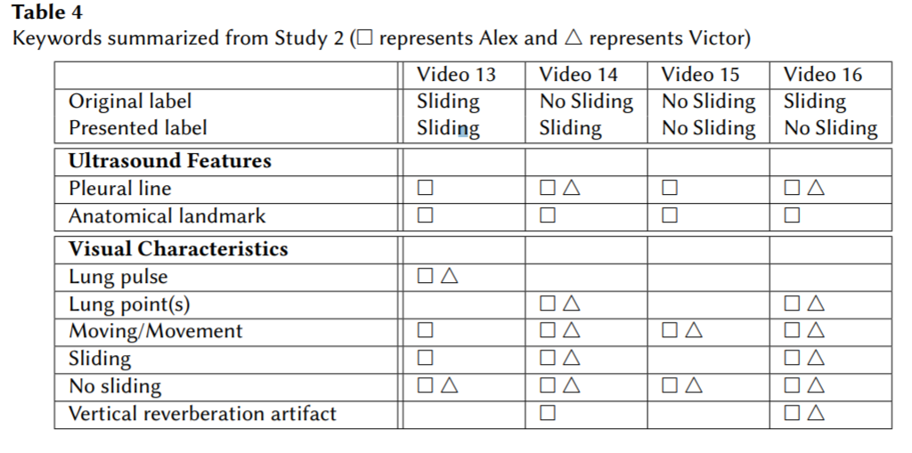
Study 2 Results
More uncertainty among doctors, but more detailed process
Notes:
- Doctors used the same concepts for both diagnosis and explanation
1.
- An interesting finding we have from this session is that both medical experts agreed to disagree with two videos. For Video 13, we showed them a video correctly labeled with “sliding”, while both doctors mentioned that they would prefer recognizing the phenomenon as a lung pulse (a vertical motion of the pleura in sync with the cardiac rhythm [21]) instead of sliding. They agreed that this is suspicious of Pneumothorax, but were unable to definitively confirm it.
- Video 16 is presented with the flipped label “No Sliding” and the ground truth BAMC label is “Sliding”. Victor described what he saw as half sliding and half no sliding. He thought the video was suspicious of Pneumothorax (i.e., no sliding) but would need more information to make the diagnosis. Alex described what he observed as “clearly sliding”.

Slide 17
Study 2 Results
Doctors recognized motion as a lung pulse rather than a sliding motion
Notes:
- Doctors used the same concepts for both diagnosis and explanation
1.
- An interesting finding we have from this session is that both medical experts agreed to disagree with two videos. For Video 13, we showed them a video correctly labeled with “sliding”, while both doctors mentioned that they would prefer recognizing the phenomenon as a lung pulse (a vertical motion of the pleura in sync with the cardiac rhythm [21]) instead of sliding. They agreed that this is suspicious of Pneumothorax, but were unable to definitively confirm it.
- Video 16 is presented with the flipped label “No Sliding” and the ground truth BAMC label is “Sliding”. Victor described what he saw as half sliding and half no sliding. He thought the video was suspicious of Pneumothorax (i.e., no sliding) but would need more information to make the diagnosis. Alex described what he observed as “clearly sliding”.

Slide 18
Study 2 Results
Victor describes the motion and “half sliding” and “half no sliding”
Alex describes the motion as “clearly sliding”
Notes:
- Doctors used the same concepts for both diagnosis and explanation
1.
- An interesting finding we have from this session is that both medical experts agreed to disagree with two videos. For Video 13, we showed them a video correctly labeled with “sliding”, while both doctors mentioned that they would prefer recognizing the phenomenon as a lung pulse (a vertical motion of the pleura in sync with the cardiac rhythm [21]) instead of sliding. They agreed that this is suspicious of Pneumothorax, but were unable to definitively confirm it.
Video 16 is presented with the flipped label “No Sliding” and the ground truth BAMC label is “Sliding”. Victor described what he saw as half sliding and half no sliding. He thought the video was suspicious of Pneumothorax (i.e., no sliding) but would need more information to make the diagnosis. Therefore, sliding motion is not distributed evenly throughout video
Alex described what he observed as “clearly sliding”.

Slide 19
Study 2 Results
Rules extracted from Alex’s Think Aloud:
Alex stated that he will always look for the pleural line first. To recognize the pleural line, he identifies anatomical landmarks such as ribs and muscle.
Next, he examines if there is any independent movement in the pleural line. If sliding is present along the entire pleural line, then he can confidently make a diagnosis of no Pneumothorax.
If he did not see sliding or only saw partial sliding, then he would look for lung pulse. Recognizing pulse would lead to a conclusion of no Pneumothorax.
Lastly, Alex would look for vertical artifacts. If there are vertical artifacts, then there is no Pneumothorax. However, if no vertical artifacts are observed, then more information is needed to make a definitive decision.
Notes:
Compared to Study 1, where both doctors did not prioritize among the ultrasound features and visual characteristics, Alex used inference rules to construct his explanations of the previously labeled lung ultrasound videos.
Through the process of explaining, Alex outlined 4 rules he follows to generate a diagnosis
Benefit
we introduce the idea of “inference rules” by prioritizing the features we extracted.
Inference rules suggest an order of detecting/recognizing ultrasound features and relevant visual characteristics, and provide the AI model with more knowledge for making classifications between Pneumothorax and no Pneumothorax.
Similar to traversing a decision tree, the AI system would have knowledge about which feature to detect first, and whether to make a classification at that point or move on to the next feature.
Disclaimer
There’s still a possibility that he cannot make a diagnosis after considering these four features sequentially.
Poor image resolution or only seeing part of the lung were the common issues preventing him from making a diagnosis.
To make a clinical decision in these cases, more ultrasound data would need to be collected to support decision making.

Slide 20
Key Takeaways
Across all Think Alouds, doctors almost always identified the pleural line as part of diagnosing Pneumothorax
Given the pleural line, the primary visual characteristic doctors used to make a diagnosis was whether the pleural line exhibited (horizontal) movement or not
Doctors used the same concepts when explaining and diagnosing, but process can change
Notes:
Expert knowledge can be effectively used to design robust AI models
Extracting domain knowledge is a form of participatory design that centers the users of the resulting research
Explanation is just as important as a recommendation
3.
- It could be the case that this task is reasonably simple

Slide 21
Design Recommendations
Our study results suggest that an automated system should employ object detection to identify ultrasound features and spatio-temporal analysis to identify visual characteristics
Further, our results suggest that this system should begin by identifying the pleural line, then diagnose Pneumothorax based on whether there is movement of the pleural line
To facilitate explainability, this system should also present information to doctors using the terms identified in our studies (pleural line, vertical artifacts, etc.)
Notes:
1
Our study results suggest that an automated system should employ object detection to identify ultrasound features and spatio-temporal analysis to identify visual characteristics
2
Further, our results suggest that this system should begin by identifying the pleural line, then diagnose Pneumothorax based on whether there is movement of the pleural line
3
To facilitate explainability, this system should also present information to doctors using the terms identified in our studies (pleural line, vertical artifacts, etc.)

Slide 22
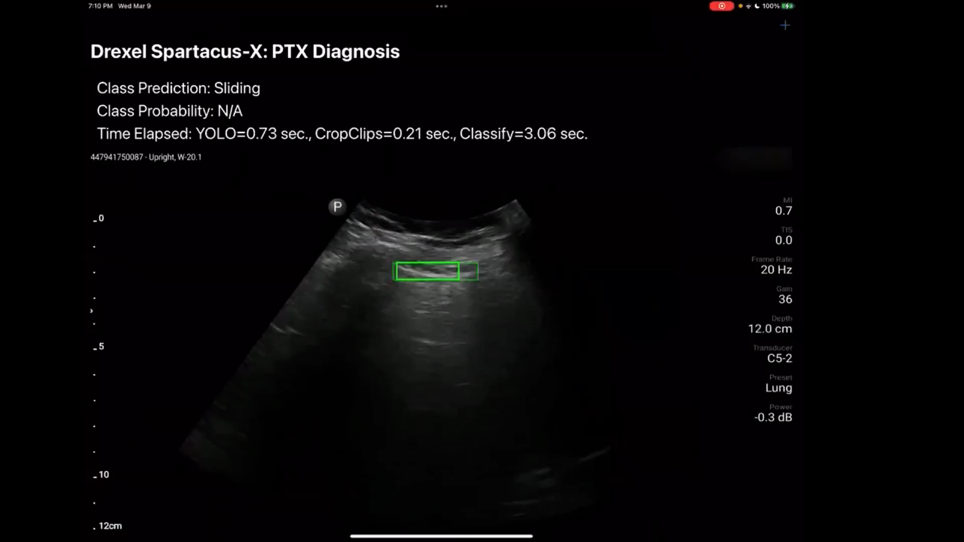
Ongoing Work
Notes:
We have translated these recommendations into an automated system
Here is a video for our system in action on an Ipad
The system starts by identifying the pleural line shown in the bounding box
It then characterizes whether there is movement by coloring the bounding box red or green
A green box means there’s movement and a red box means there’s no movement
Finally, an overall sliding or no sliding labeling for the video is based on whether movement or no movement is dominant across the video
We trained this model using only 15 positive examples and 30 negative examples
The model was then evaluation by the FDA on an unseen test set and achieved >90% accuracy, which was the current state of the art for CNNs trained with more data
We’re excited about how the domain knowledge from these think alouds, which we use to structure how the model works, directly translates into improved performance even in situations with limited data
We’re happy to talk about our ongoing work if you have any questions

Slide 23
Thank you! Questions?
Glen Smith
PhD Student, Drexel University
glen.r.smith@drexel.edu
Qiao Zhang
PhD Student, Drexel University
qz99@drexel.edu
Christopher J. MacLellan
Assistant Professor, Drexel University
christopher.maclellan@drexel.edu
https://tail.cci.drexel.edu

